Slide 1
VBA coding for Excel
Chelsea Dohemann

Slide 2

Lunch Time
Continue at 1pm

Slide 3
Today We’re Going to Cover
Day 1
Morning
Afternoon
Introduction to Macros
Recording Macros
Editing Macros
VBA Interface
Macro Security
Debugging
Customizing Ribbon and Toolbars
VB Grammar
Inserting & Formatting Text
Sorting Data
Variables & Operators
Duplicating Data
Generating Reports
Various Properties, Objects and Methods
Notes:
Content for this visual comes from the OV Data transformation in Epic

Slide 4
Today We’re Going to Cover
Day 1
Morning
Afternoon
Introduction to Macros
Recording Macros
Editing Macros
VBA Interface
Macro Security
Debugging
Customizing Ribbon and Toolbars
VB Grammar
Inserting & Formatting Text
Sorting Data
Variables & Operators
Duplicating Data
Generating Reports
Various Properties, Objects and Methods
Notes:
Content for this visual comes from the OV Data transformation in Epic

Slide 5

Object-Oriented Programming
Object
Color
Purpose
Size
Modelled like real time objects

Slide 6
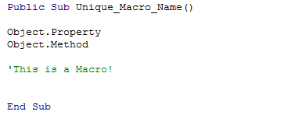
Macros

Slide 7
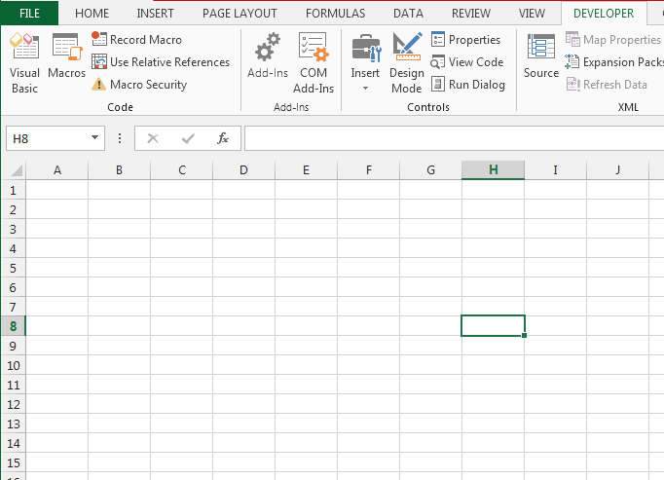
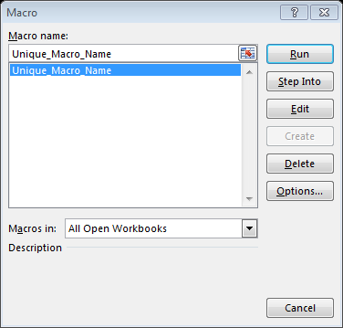

Macro Options

Slide 8
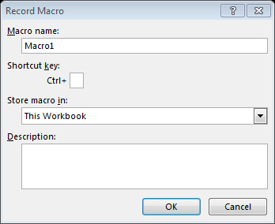
The Macro Recorder

Slide 9
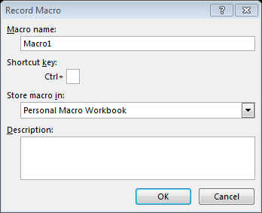
Personal Macro Workbook

Slide 10
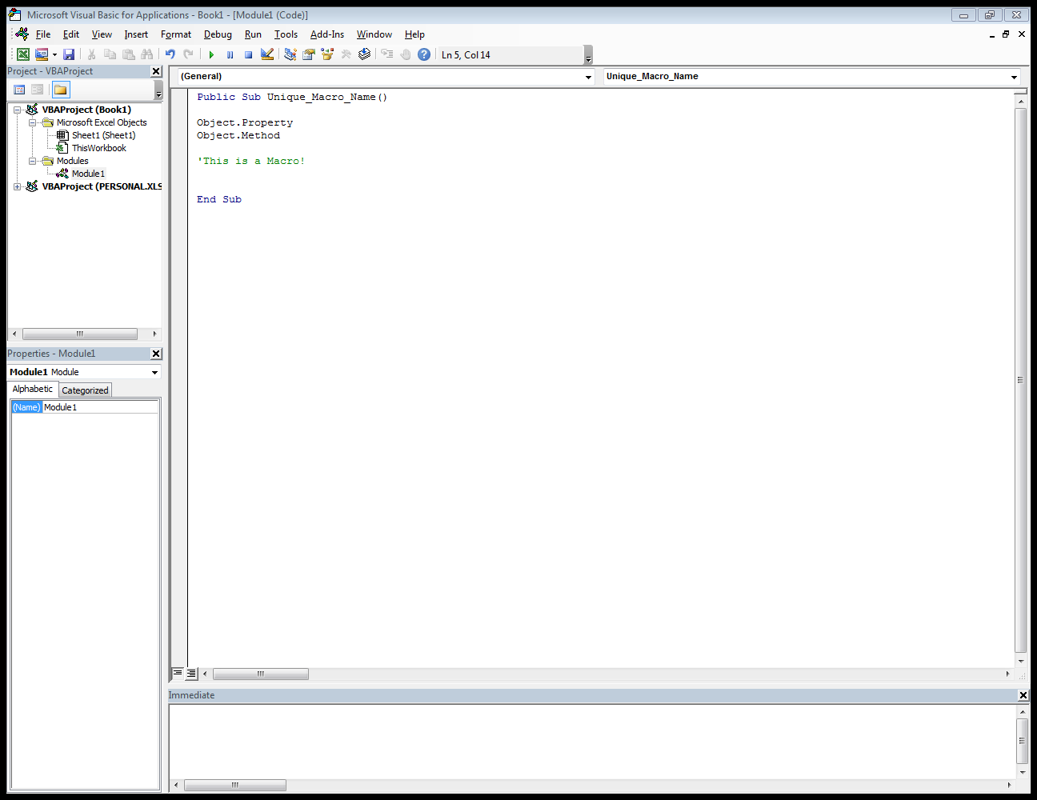
Visual Basic Editor
Project Explorer
Code Window
Properties Window
Immediate Window

Slide 11
Modules

Slide 12
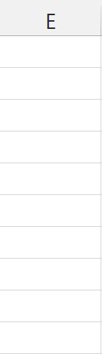



Objects
Columns
Cells
A1
Sheets
Tables
Charts
Rows

Slide 13
Hierarchy of Objects
Application
Workbooks
Worksheets
Ranges
Columns
Rows

Slide 14
Properties
A1
A1
.Color
$100
$1,000,000
.Value
Text
Text
.Font

Slide 15
Methods
Copy
Copy
Clear Contents
Auto
Fit
Columns

Slide 16
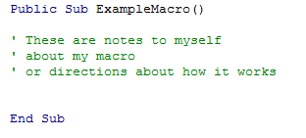
VBA Comments

Slide 17
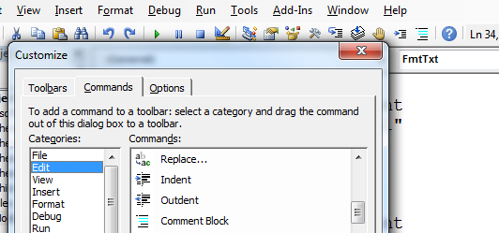
“comment out” a block all at once

Slide 18
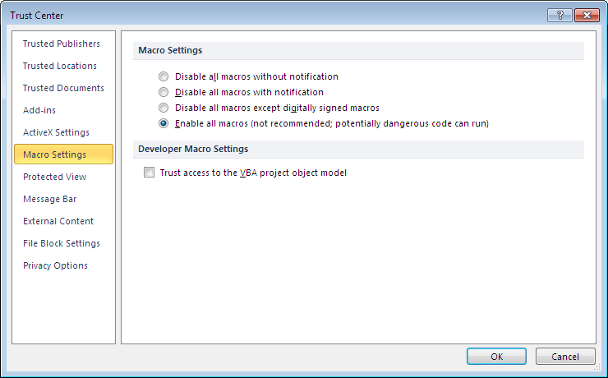
Macro Security Settings

Slide 19
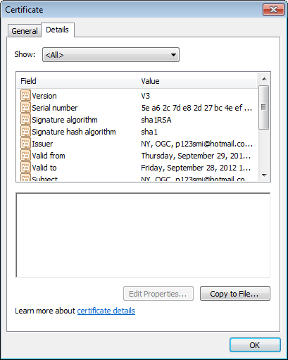
Digital Certificates

Slide 20
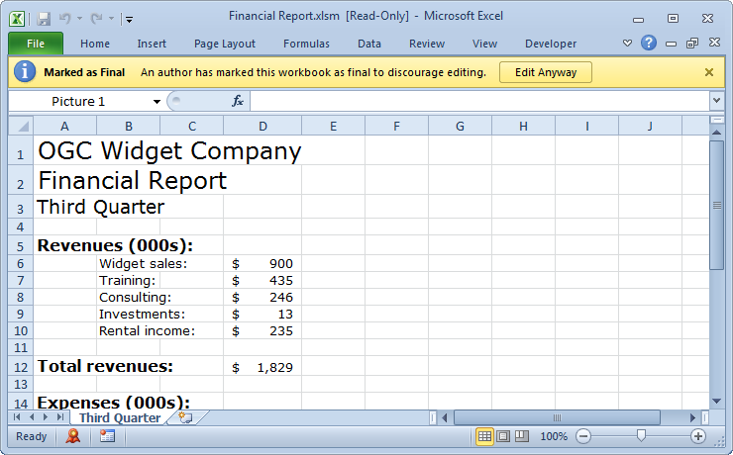
Digital Signatures

Slide 21
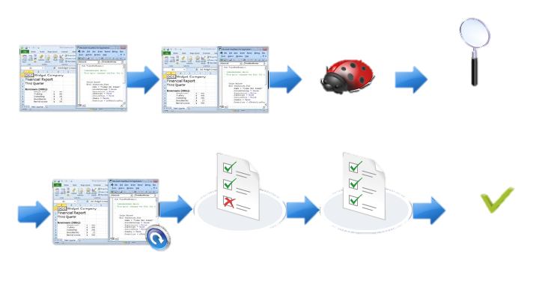
The Debugging Process
Determine problem
Set up environment
Back up
Run code with error
Execute code line by line to find the error
Retest to ensure error is fixed
Reset Data
Fix code error

Slide 22
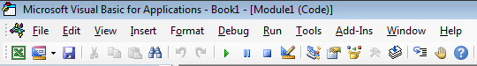
Debugging Tools
Toggle Breakpoint
Run Macro
Exit Break-Mode
Compile
Step-Into

Slide 23
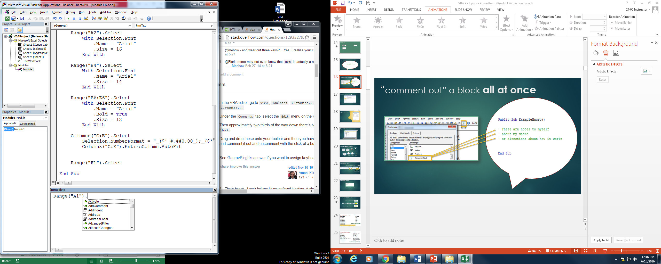
Intellisense Window
Methods
Properties
Objects

Slide 24
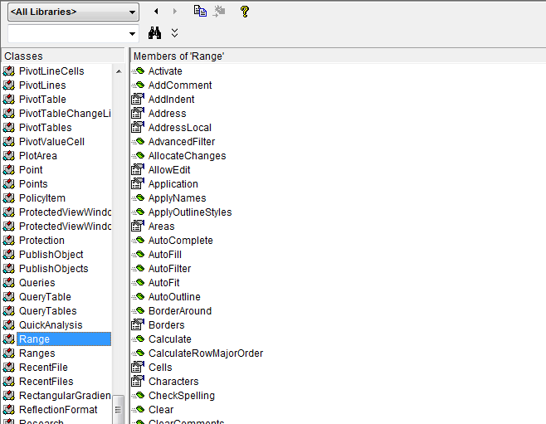
Object Browser

Slide 25
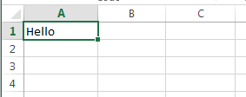
The Range Object
Range (“A1”) . Value = “Hello”

Slide 26
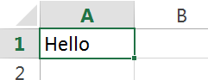
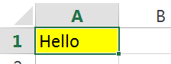
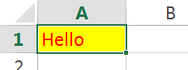
Using the Range object
Range (“A1”) . Value = “Hello”
Range (“A1”) . Interior . Color = vbYellow
Range (“A1”) . Font . Color = vbRed

Slide 27
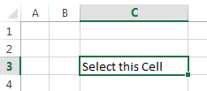
Different ways to express the same Range
Range(“C3”)
Range(“B2”).Range(“B2”)
Cells(3,3)
[C3]
Range(“A1”).Offset(2,2)
MyRange = “C3”
Range(MyRange)

Slide 28
Color Options in VBA
Theme Colors
xlThemeColorLight1
xlThemeColorDark1
xlThemeColorDark2
xlThemeColorlight2
xlThemeColorAccent1
xlThemeColorAccent2
xlThemeColorAccent3
xlThemeColorAccent4
xlThemeColorAccent5
xlThemeColorAccent6
VB Colors
vbBlack
vbWhite
vbRed
vbLine
vbYellow
vbBlue
vbMagenta
vbCyan
Range (“A1”) . Font . Color = vbRed
Range (“A1”) . Font . ThemeColor = xlThemeColorLight1

Slide 29
Color Options in VBA
RGB Colors
Blue – ( 0 , 0 , 255 )
Yellow – ( 255 , 255 , 0 )
Cyan – ( 0 , 255 , 255 )
Magenta – ( 255 , 0 , 255 )
Hexidecimal (Hex)
Blue – 16711680
Yellow – 65535
Cyan – 16776960
Magenta – 16711935
(Can’t have the # sign, which people are used to seeing with the hex code)
Range (“A1”) . Font . Color = RGB(1,1,1)
Range (“A1”) . Font . Color = 65535

Slide 30
The Selection Object
Selection . Value = “Hello”

Slide 31
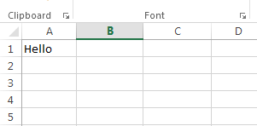
The Value Property
Range(“A1”) . Value = “Hello”

Slide 32
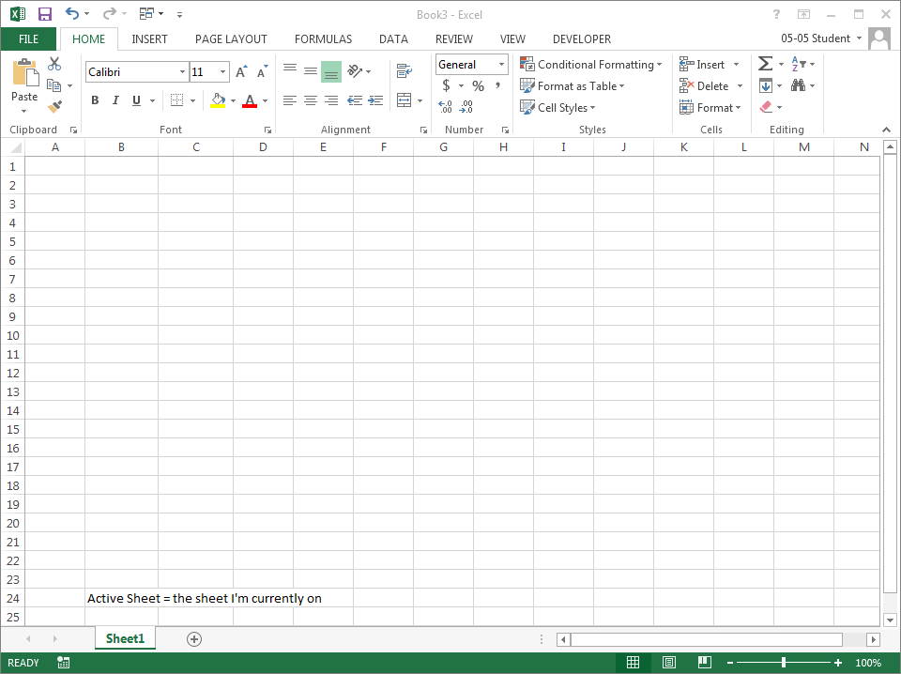
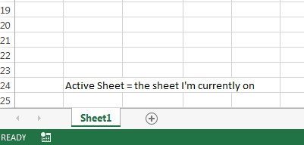
The ActiveSheet Object
ActiveSheet . Name = “Sheet1”

Slide 33
The Name Property
ActiveSheet . Name = “Sheet1”

Slide 34
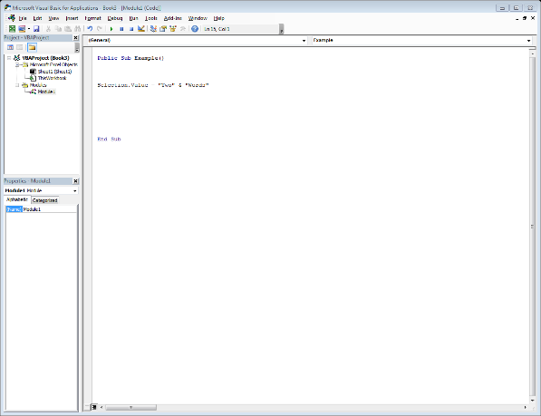
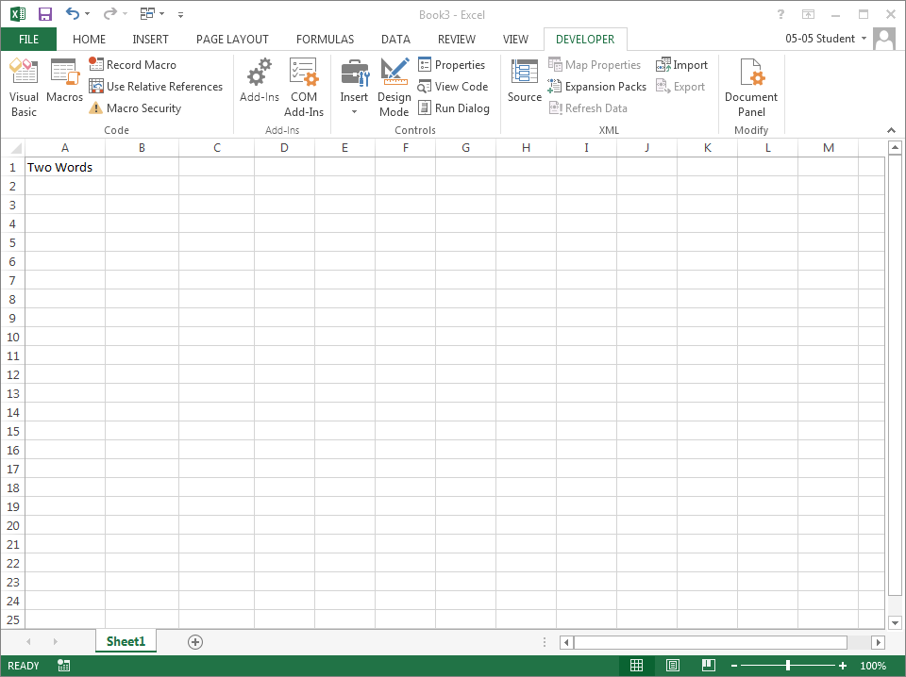
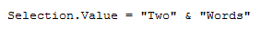
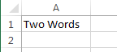
Concatenation
&

Slide 35
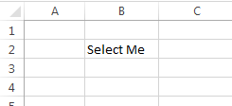
The Select Method
Range(“B2”) .
Select

Slide 36
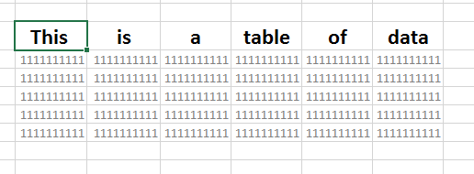
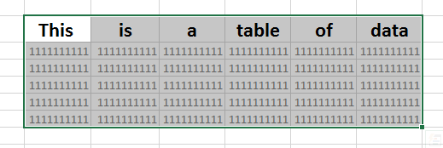
The CurrentRegion Property
Range(“A1”) . CurrentRegion . Select

Slide 37
Practice
Insert Headers
Format Headers, and Columns
Format Cell Interior of Lists

Slide 38
Variables
Data Storage

Slide 39
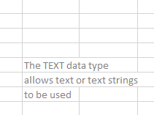
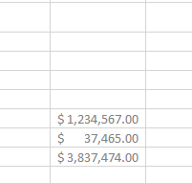
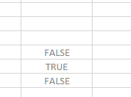
Different Data Types
Text
Number
Boolean
≠
≠

Slide 40
Common Data Types
Numbers
Decimal
Double
Integer
28 decimal placeholders
14 bytes
Gazillians
8 bytes
-2M – 2M
2 bytes
Text
Variant
String
Char
All
16-32 bytes
2B characters
Depends
0 - 65535
2 bytes
Misc
Date
Object
1900-9999
8 bytes
Any
4-32 bytes
Range
Any
4-32 bytes
Boolean / Byte
Boolean
Byte
True / False
2 bytes
0-255
1 byte

Slide 41
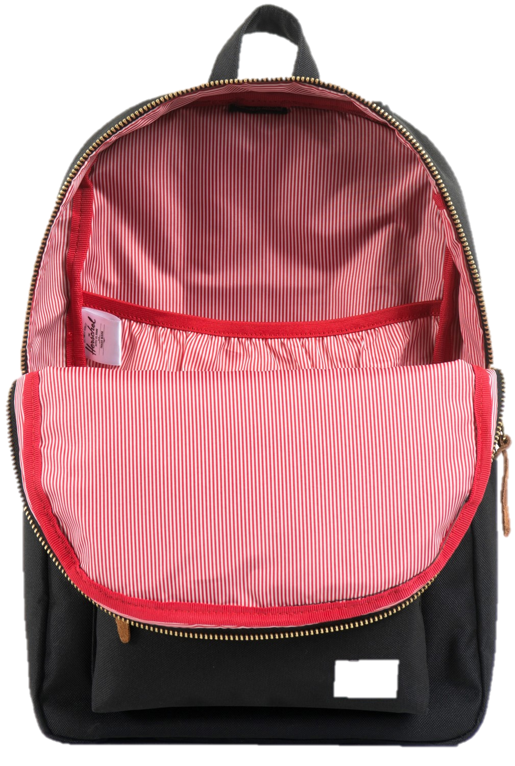
Variables
Sunshine? Or Clouds?
Sunshine
Clouds
Sunshine
Stores a bit of Code
Delivers that code to some kind of process

Slide 42
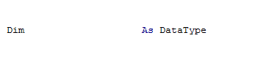
Stating Variables
NameofVariable
Variable Declaration:
“Okay VBA, I’m making a variable”
Data Type:
“This is going to be a number”
or “Text” or “Boolean”

Slide 43
Exercise: Create some Variables
String
Name: ExString
Data: “This is Dummy Text”
Make A1’s value the example text
Integer
Name: ExInteger
Data: 5.5
MsgBox “Value is” & example value
Double
Name: ExDouble
Data: 5.5
MsgBox “Value is” & example value
Boolean
Name: ExBoolean
ExBoolean = True
If ExBoolean = True then MsgBox “Boolean variables are cool!”

Slide 44
(Math) Operators
+ - * /
< > = <>

Slide 45
Loops
To repeat actions multiple times

Slide 46
The For Next Loop
Open “For Next Loop” XLSM
To make an action repetitive (a specific number of repetitions)
Scenario:
We want to input the value “100” multiple times into some cells.
Strategy:
We’ll make a variable called “x” and use it to stand in for the numerical value of each iteration of the loop.

Slide 47
The For Next Loop
First: Define your variable
Dim x as Integer

Slide 48
The For Next Loop
Next: Write the code that we want to repeat
Dim x as Integer
Range(x, 1).Value = 100

Slide 49
The For Next Loop
Next: Wrap the For-Next Loop around the code to repeat it
Dim x as Integer
For
Range(x, 1).Value = 100
Next

Slide 50
The For Next Loop
Next: enter the code to establish he number of times this should repeat
Dim x as Integer
For x = 1 - 10
Range(x, 1).Value = 100
Next

Slide 51
The For Next Loop
Finish: complete the Next statement, tell it to move to the next x
Dim x as Integer
For x = 1 - 10
Range(x, 1).Value = 100
Next x

Slide 52
The For Next Loop
Challenge! Try out the two other For Loop examples in this workbook.
“For Next Loop” xlsm

Slide 53
Rehearse For Next Loop
Design a Variable
For Next Loop (For x = 1 to ………..)
Inside the Loop
Select Worksheet(x)
Start with A1
Select Current Region
Copy Content
Select Sheet to paste on
Select cell to start with
Insert offset function
Paste
End the Loop

Slide 54
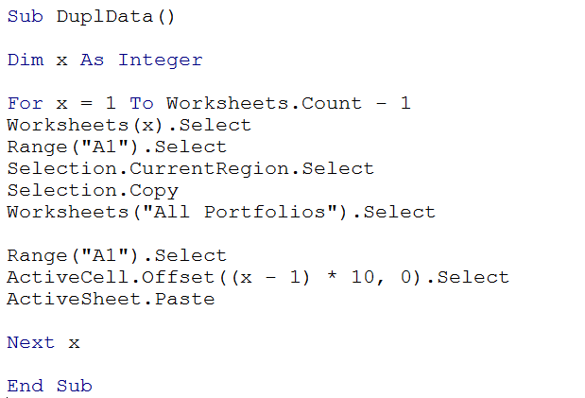
For Next Loop Answer

Slide 55
The Do While Loop
Open “Do While Loop” XLSM
To repeat an action, until a specific criteria is met
Scenario:
We want to input the value “100” multiple time, until we reach Row 10.
Strategy:
We’ll make a variable called “x” and use it to stand in for the numerical value of each iteration of the loop.

Slide 56
The Do While Loop
First: Define your variable
Dim x as Integer

Slide 57
The Do While Loop
Then: Define your starting value
Dim x as Integer
X = 1

Slide 58
The Do While Loop
Then: Write the code that you want to repeat
Dim x as Integer
x = 1
Cells(x, 1).Value = 100

Slide 59
The Do While Loop
Then: Surround the repeated code with a Do While Loop
Dim x as Integer
x = 1
Do While
Cells(x, 1).Value = 100
Loop

Slide 60
The Do While Loop
Then: code the criteria for stopping the loop
Dim x as Integer
x = 1
Do While x < 10
Cells(x, 1).Value = 100
Loop

Slide 61
The Do While Loop
Then: code the statement to count up after you’ve executed the repeatable code
Dim x as Integer
x = 1
Do While x < 10
Cells(x, 1).Value = 100
x = x + 1
Loop

Slide 62
The Do While Loop
Challenge! Try out the two other For Loop examples in this workbook.
“Do While Loop” xlsm

Slide 63
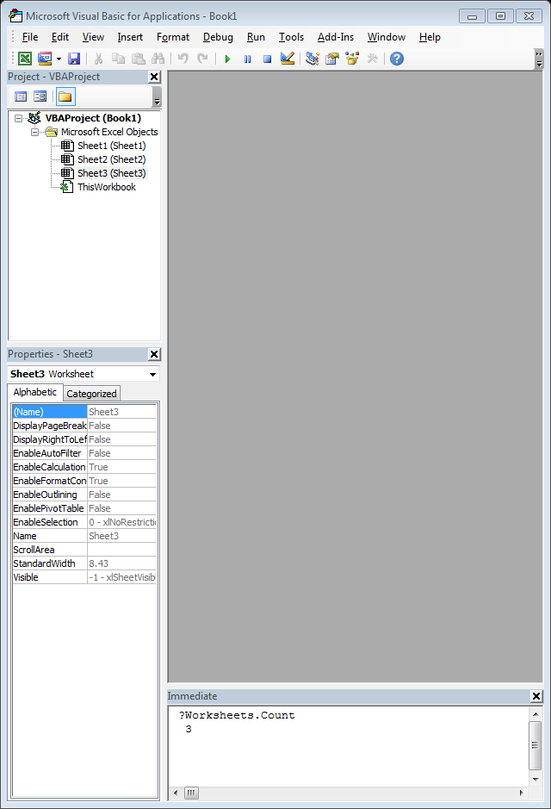
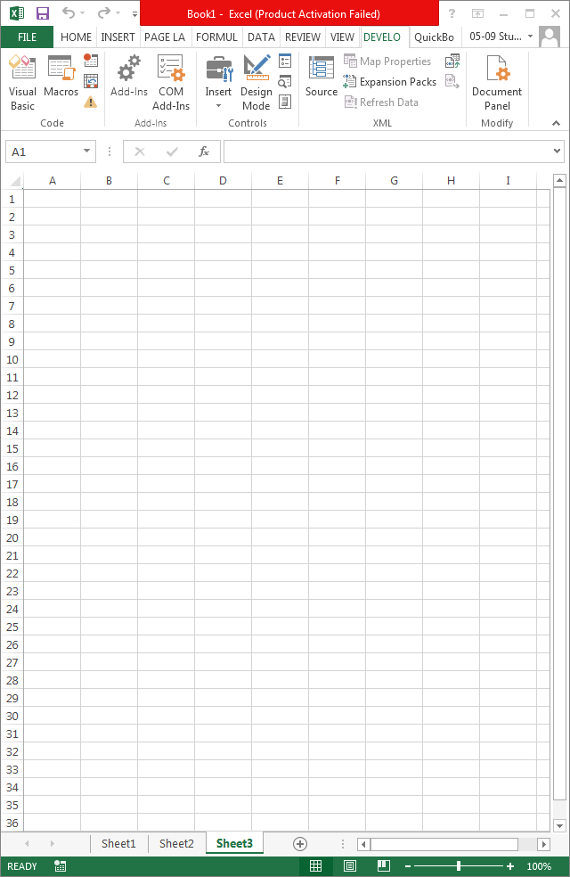
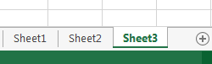
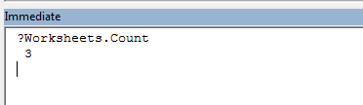
The Count Property

Slide 64
The Offset Property
Moves our cell selection using relative cell relationships
Navigates up or down Rows
Offset( 1 , 1 )
Navigates left or right across columns

Slide 65
The Offset Property
Positive Numbers = Down
Negative Numbers = Up
Offset( 1 , 1 )
Positive Numbers = Right
Negative Numbers = Left

Slide 66
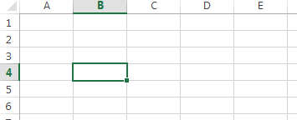
The Offset Property
Offset(1, 1)
Offset(-1, -1)

Slide 67
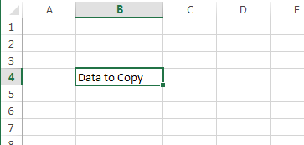
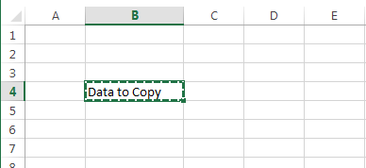
The Copy Method
Selection.Copy

Slide 68
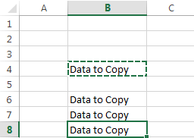
The Paste Method
ActiveSheet.Paste

Slide 69
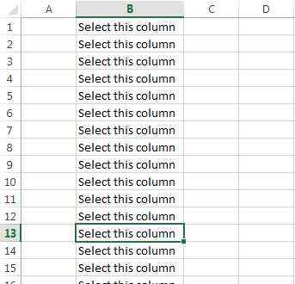
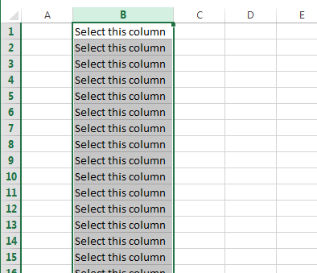
The Columns Property
Columns(“B:B”).Select

Slide 70
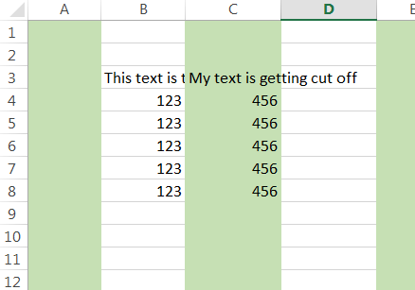
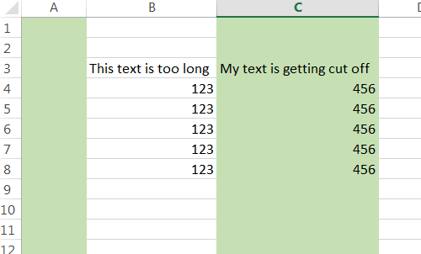
The AutoFit Method
Doesn’t fit!
Now it fits!
Columns(“B:C”).AutoFit

Slide 71

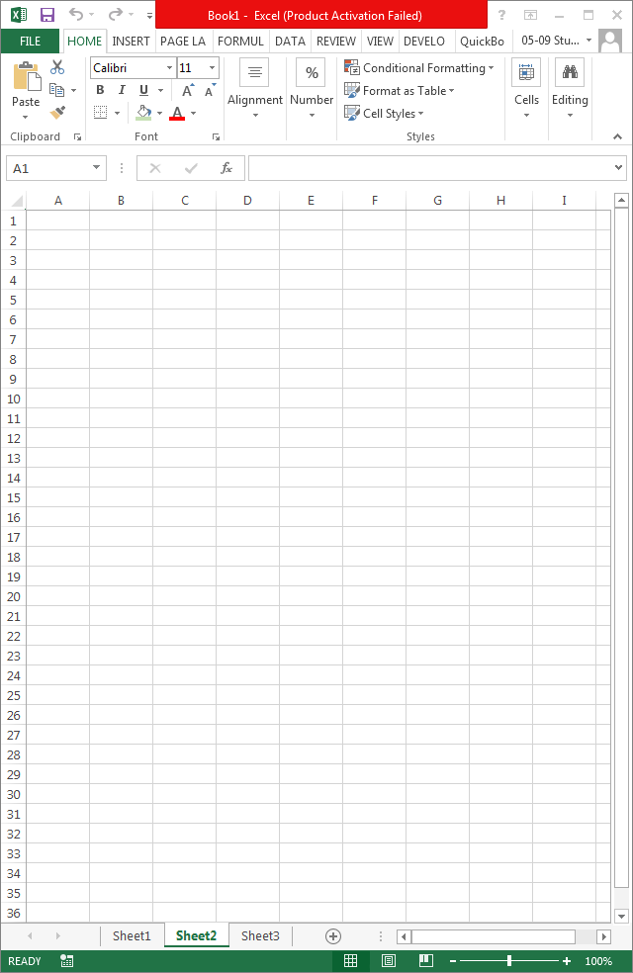


The Address Property

Slide 72

The Call Statement
We can have a Procedure run other macros using the “Call” statement

Slide 73


The Font Property
ActiveCell.Font.Name = “Verdana”

Slide 74



The End Property
ActiveCell.End(x1Down)
ActiveCell.End(x1toRight)

Slide 75




Message Boxes

Slide 76







MsgBox options
MsgBox “Message”, vbOption, “Message Box Title”
vbYesNo
vbMsgBoxHelpButton
vbOKCancel
vbOKOnly
vbYesNoCancel
vbRetryCancel
vbInformation

Slide 77



Input Boxes
Type text here.

Slide 78
Input Boxes
Question
Default Text
Name of Box

Slide 79

Constants
Declaring constants works a lot like declaring variables, EXCEPT the value has to be defined at the same time.
Constant Declaration:
“Okay VBA, I’m making a constant”
Constant Value:
“The value of this constant is…”

Slide 80

The Code Continuation Character _
To be safe, always precede it with a space

Slide 81

The vbCrLf Constant

Slide 82
Decision Structures
Run a statement if a condition is TRUE
Code blocks that allow us to:
…previous code….
Is the Condition TRUE?
YES
no
Perform actions for TRUE
Do nothing
Next code…

Slide 83
Decision Structures
Run a statement if a condition is TRUE, and another if FALSE
Code blocks that allow us to:
…previous code….
Is the Condition TRUE?
YES
NO
Perform actions for TRUE
Perform actions for FALSE
Next code…

Slide 84
Decision Structures
Run a statement if a condition is FALSE,
Code blocks that allow us to:
…previous code….
Is the Condition TRUE?
yes
NO
Perform actions for TRUE
Perform actions for FALSE
Next code…

Slide 85


The IF THEN Structure
If B4 is greater than 60
Enter “Pass” in C4

Slide 86

The IF THEN ELSE Structure
If B4 is greater than 60
Enter “Pass” in C4
If B4 is LESS than 60
Enter “Fail” in C4

Slide 87

If Then Else Structures can get looong…
Way too much typing.

Slide 88

The Select Case Structure
**Use & define a variable
Let’s look as cases for X
In this case
Do this
In this case
Do this
In this case
Do this
In every other case
Do this
Done

Slide 89
Select Case – Case Options
To check if a case is a Text value
To check if a case is a Number(s)
Case “Word”
Case 1, 2
To check if a case is a number Range
To check if a case Compares
Case 1 To 10
Case Is < 100

Slide 90

The Add Method
Worksheets.Add

Slide 91
The Add Method
Worksheets.Add Before:=Worksheets(3)

Slide 92
The Add Method
Worksheets.Add After:=Worksheets(1)

Slide 93


The Copy Method
Worksheets(2).Copy Before:=Worksheets(4)
Worksheets(2).Copy After:=Worksheets(2)

Slide 94
The Delete Method
Worksheets(2).Delete

Slide 95


The DateSerial Function
Range(“A1”).Value = DateSerial(2011, 11, 28)
Range(“A1”).Value = DateSerial(2011-1, 11-1, 28-1)

Slide 96



The Format Function (for Dates)
Note! This returns a text value, date’s serial number is lost

Slide 97


The Format Function (for Non-Dates, Main Categories)
General Number
Standard
Currency
Percent

Slide 98

The Number Format Option
Unlike the Format Function, this just changes the formatting of the number;
Maintains the serial number for the date

Slide 99
The Move Method
Worksheets(2).Move Before:=Worksheets(4)
Worksheets(2).Move After:=Worksheets(2)

Slide 100
The PrintPreview Method
Worksheet
object reference
Previews all the worksheets in the workbook
Worksheets.PrintPreview
Worksheets(2).PrintPreview
Worksheets(“SE Sales”).PrintPreview
Previews the second worksheet
in the workbook
Previews the worksheet
named SE Sales

Slide 101
The PrintOut Method
Worksheet
object reference
Prints all the worksheets
in the workbook
Worksheets.PrintOut
Worksheets(2).PrintOut
Worksheets(“SE Sales”).PrintOut
Prints the second worksheet
in the workbook
Prints the worksheet
named SE Sales

Slide 102
User-Defined Functions
Function Name
Optional variables
Beginning
statement
Public Function Pricelevel(amount, byr, eyr)
If byr < 1913 Or byr > 2003 Or eyr < 1913 or eyr > 2003 Then
PriceLevel = 0
Else
PriceLevel = amount * CPI_idex(eyr) / CPI_idex(byr)
End If
End Function
Processing
code
Result placed into a variable having the function name
Closing
statement

Slide 103

Arguments
Data sent from worksheet
to function for processing
Public Function PriceLevel(amount, byr, eyr)
Arguments listed within parentheses

Slide 104
Declared Range Objects
Dim MyRange As Range
Range object name

Slide 105

The Set Statement
Set MyRange = Range(“A2:E5”)

Slide 106
The Rows Property
Set MyRange = Range(“A2:E5”)
MyRange.Rows(3)

Slide 107
The Formula Property
Formula property attached to
Range object
MyRange.Formula = “=SUM(A1:C6)”

Slide 108
The Columns Property
Set MyRange = Range(“A2:E5”)
MyRange.Columns(3)

Slide 109
Format Function possibilities
General Number | Displays a number without thousand separators.
Currency | Displays thousand separators as well as two decimal places.
Fixed | Displays at least one digit to the left of the decimal place and two digits to the right of the decimal place.
Standard | Displays the thousand separators, at least one digit to the left of the decimal place, and two digits to the right of the decimal place.
Percent | Displays a percent value - that is, a number multiplied by 100 with a percent sign. Displays two digits to the right of the decimal place.
Scientific | Scientific notation.
Yes/No | Displays No if the number is 0. Displays Yes if the number is not 0.
True/False | Displays False if the number is 0. Displays True if the number is not 0.
On/Off | Displays Off if the number is 0. Displays On is the number is not 0.
General Date | Displays date based on your system settings
Long Date | Displays date based on your system's long date setting
Medium Date | Displays date based on your system's medium date setting
Short Date | Displays date based on your system's short date setting
Long Time | Displays time based on your system's long time setting
Medium Time | Displays time based on your system's medium time setting
Short Time | Displays time based on your system's short time setting

Slide 110
Time for a Break
We’ll resume class at 2:50pm

